Slide 1
Supervised/Unsupervised/Reinforcement Learning
Supervised
Labeled data used to "train" the machine learning system to recognize certain rules for correlating inputs to outputs.
Example: facial recognition
Unsupervised
Labels are omitted. The machine learning system finds structures and patterns in the data on its own
Example: identify target customer using clustering algorithm
Reinforcement
Evaluations are given about how good or bad a certain situation is
Example: self-driving vehicles.

Slide 2
Examples of Supervised/Unsupervised Learning
Type | Model/ Algorithm or Task | Description | Usage Examples in Business
Supervised | Neural network | Computations are structured in terms of interconnected groups, much like the neurons in a brain. Neural networks are used to model complex relationships between inputs and outputs to find patterns in data or to capture a statistical structure among variables with unknown relationships. They may also be used to discover unknown inputs (unsupervised). | Predicting financial results Fraud detection
Supervised | Classification and/or regression | Computations are structured in terms of categorized outputs or observations based on defined classifications. Classification models are used to predict new outputs based on classification rules. Regression models are generally used to predict outputs from training data. | Spam Filtering Fraud detection
Supervised | Decision tree | Computations are particular representations of possible solutions to a decision based on certain conditions. Decision trees are great for building classification models because they can decompose datasets into smaller, more manageable subsets. | Risk assessment Threat management systems Any optimization problem where an exhaustive search is not feasible
Unsupervised | Cluster analysis | Computations are structured in terms of groups of input data (clusters) based on how similar they are to one another. Cluster analysis is heavily used to solve exploratory challenges where little is known about the data. | Financial transactions Streaming analytics in IoT Underwriting in insurance
Unsupervised | Pattern recognition | Computations are used to provide a description or label to input data, such as in classification. Each input is evaluated and matched based on a pattern identified. Pattern recognition can be used for supervised learning as well. | Spam detection Biometrics Identity management
Source: Preparing and Architecting for Machine Learning, Gartner Group Published 17 January, 2017

Slide 3
Data Mining Tasks
Descriptive methods
Find human-interpretable patterns that describe the data
Example: Clustering (e.g. customer segmentation)
Predictive methods
Use some variables to predict unknown or future values of other variables
Example: Classification / Regression

Slide 4
DBMS, OLAP, and Data Mining
 | DBMS | OLAP | Data Mining
Task | Extraction of detailed and summary data | Summaries, trends and forecasts | Knowledge discovery of hidden patterns and insights
Type of result | Information | Analysis | Insight and Prediction
Method | Deduction (Ask the question, verify with data) | Multidimensional data modeling, Aggregation, Statistics | Induction (Build the model, apply it to new data, get the result)
Example question | Who purchased mutual funds in the last 3 years? | What is the average income of mutual fund buyers by region by year? | Who will buy a mutual fund in the next 6 months and why?

Slide 5
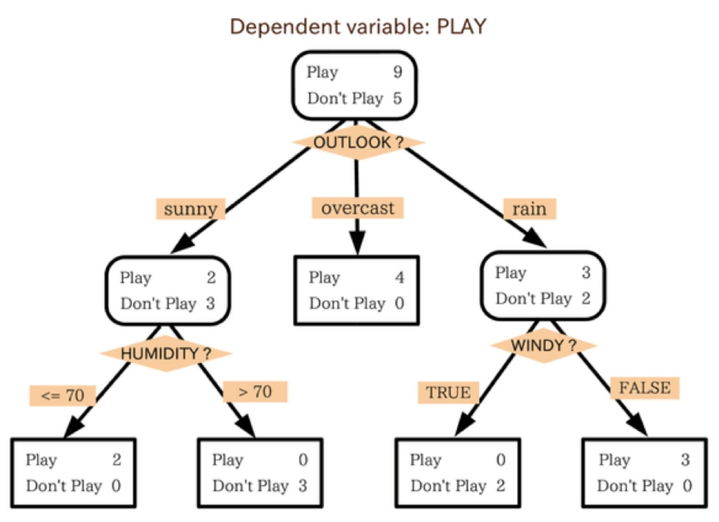
Trees and Forests

Slide 6
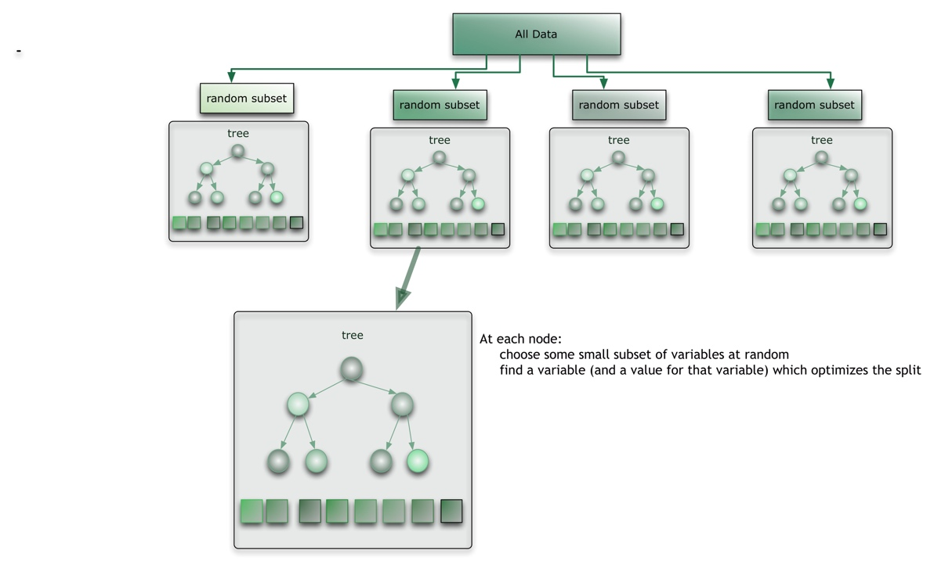
Random Forest

Slide 7
Data Cleansing in 5 Steps
Data validation
Formatting data to a common value (standardization / consistency)
Cleaning up duplicates
Filling missing data vs. erasing incomplete data
Detecting conflicts in the database

